Slide 1
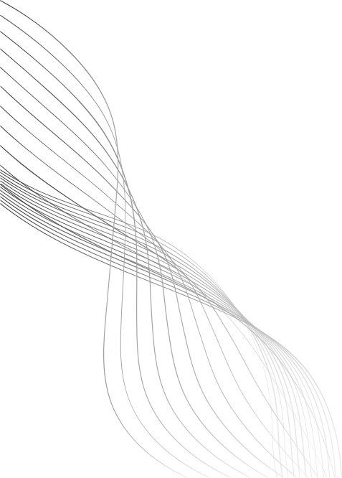
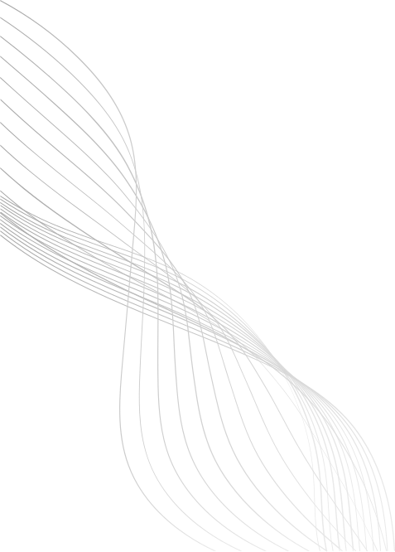
STUDENT NAME: Lokeshwar R
REGISTER NO / ROLL NO: 24H249
NM ID(username): BF51285AA656CC98CAF479A063333A36
DEPARTMENT: BCA
COLLEGE AND UNIVERSITY: A.M.Jain college and University of Madras

Slide 2


DIGITAL PORTFOLIO
By Lokeshwar R

Slide 3
AGENDA
1.PROBLEM STATMENT
2. PROJECT OVERVIEW
3. END USERS
4. TOOLS AND TECHNOLOGIES
5. PORTFOLIO DESIGN AND LAYOUTS
6. FEATURES AND FUNCTIONALITY
7. RESULTS AND SCREENSHOTS
8. CONCLUSIONS
9. GITHUB LINK
01

Slide 4
PROBLEM STATEMENT
A digital portfolio is needed because it gives students one organized space to collect, reflect, and showcase their learning, skills, and achievements. Unlike marksheets or paper files, it shows the complete growth journey of a student what they learned, how they improved, and what they can actually do. It helps teachers track progress, students build confidence, and recruiters or universities see real abilities beyond grades. In today’s digital world, having an online portfolio is not just useful, it’s essential for personal branding, career opportunities, and lifelong learning.
02

Slide 5
PROJECT OVERVIEW
Brief Summary Of My Portfolio Project - My portfolio is a personal website designed to showcase my profile, technical skills, projects, and contact details in a simple professional look.
03

Slide 6
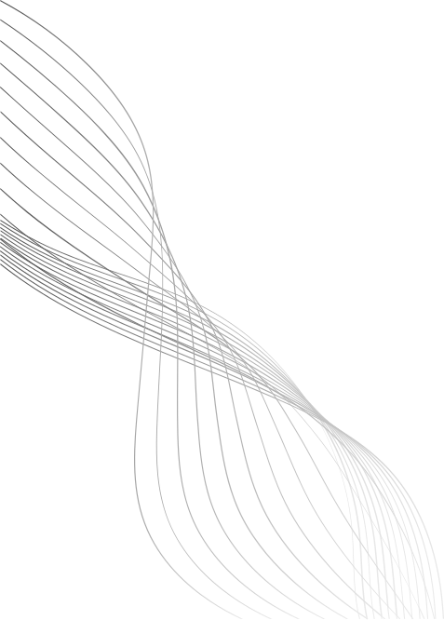
WHO ARE THE END USERS
1.Recruiters & Hiring Managers – People who want to quickly see my skills, projects, and contact info when considering me for internships or jobs.
2. Peers & Collaborators – Other students, developers, or teammates who might want to connect, collaborate, or get inspired by my work.
3. Teachers & Evaluators – Faculty members or mentors who review my projects as part of academics or assessments.
04

Slide 7
TOOLS USED FOR THIS PORJECT
HTML5 → Structure (header, about, projects, contact, footer).
CSS3 → Styling (gradient header, flexbox layout, hover effects, shadows, rounded corners).
JavaScript → Smooth scrolling + welcome message.
05

Slide 8
PORTFOLIO DESIGN AND LAYOUT
1. Modern Gradient Header with navigation links.
2. Profile Section with circular image + about text (flexbox layout).
3. Projects Section with hover-effect cards.
4. Contact Section with email + LinkedIn.
5. Footer with copyright.
6. Consistent spacing, rounded corners, shadows for a clean, modern look.
06

Slide 9
FEATURES AND FUNCTIONALITY
Responsive Layout using flexbox (works on different screen sizes).
Smooth Scrolling for navigation links.
Hover Effects on project cards for interactivity.
Profile Picture Support in About section.
Welcome Message (console log).
07

Slide 10
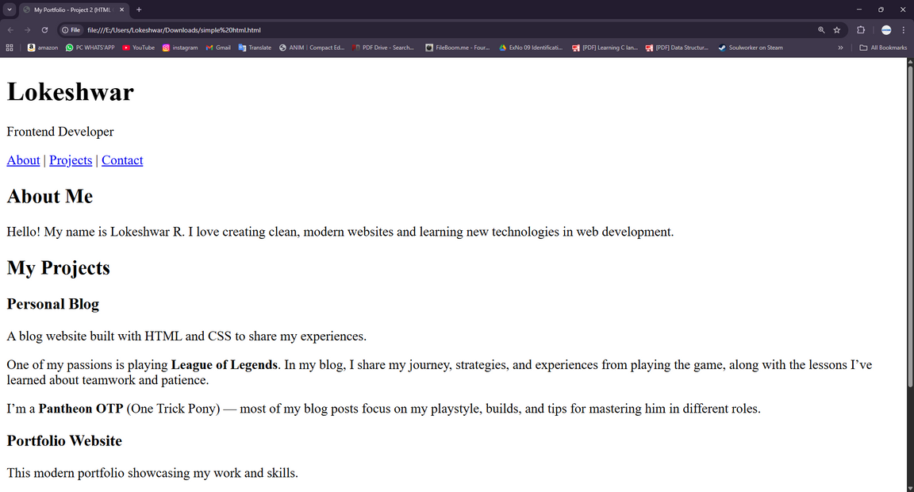
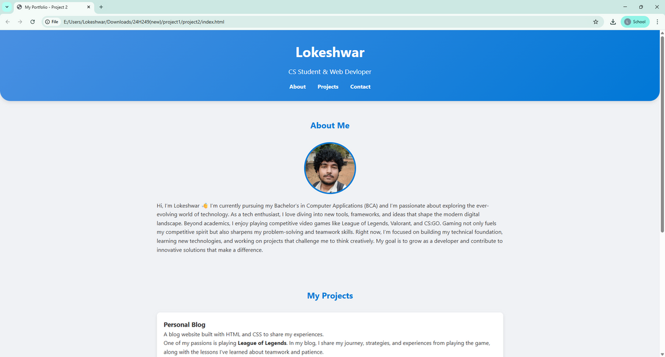
RESULTS AND SCREENSHOTS
BEFORE AND AFTER USING CSS & JS
08

Slide 11
CONCLUSION
The digital student portfolio provides a centralized platform to showcase skills, achievements, and growth beyond grades. It not only enhances learning and self-reflection but also improves opportunities for higher studies and career development.
09

Slide 12
GITHUB LINK
server link: https://github.com/24H249/TNSDC-FWD-DP1.git
Deployment link: https://24h249.github.io/TNSDC-FWD-DP1/
10

Slide 13
THANK YOU
11

